Slide 1


The Research of Data Analyst Employment Prospect
Group 6：LU Xinyi 19453833
WU Xuezi 19428766
HE Liping 19435762
XU Shibo 19446616

Slide 2


01
Project Review
CONTENTS
02
Data Exploration
03
Model Exploration
04
Evaluation & Conclusion
05
Further Improvements
06
References

Slide 3



PART 01
Project Review

Slide 4

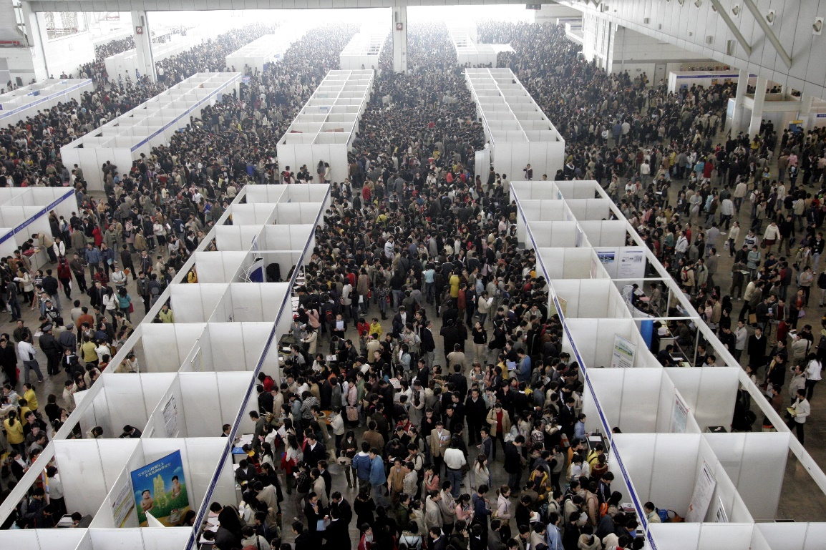


CHAPTER 1-Project Review
Recruitment website information is messy and complex, and it always takes time to screen suitable recruitment information.
There is no intelligent recommendation ranking function for search positions on recruitment websites. It usually takes a lot of time to filter out favorite or suitable job information.
As a student of data analysis, we hope that through analysis and modeling, we can get a model that can predict the future development of a job by predicting salary, which can be used as a new function for Intelligent recommendation ranking for job search engines on recruitment websites.

Slide 5

PART 02
Data Exploration

Slide 6





CHAPTER 2-Data Sources
Crawling
Screening
Clearing
Final dataset
Using python to crawl data from 51.job.com and getting 7000 initial data points.
Screening and keeping about 1500 messages. (Because there are a lot of irrelevant jobs information.)
Clearing out the data points with missing information.
Finally get 1260 data points.

Slide 7
CHAPTER 2-Structure of Dataset
variables | Type | variables | Type
Job Name | Character | Type | Character
Salary | Numeric | Scale | Numeric
Location | Character | Field | Character
Experience Requirements | Numeric | Company Details | Character
Academic Requirements | Character | Job Introduction | Character
Recruitment | Numeric | Job details | Character
Company Name | Character
Because there are many character type’s variables, some variables need to be processed in special ways.

Slide 8
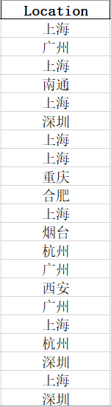
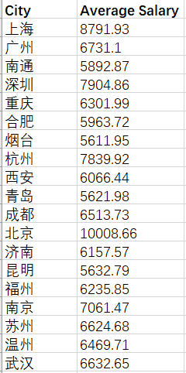
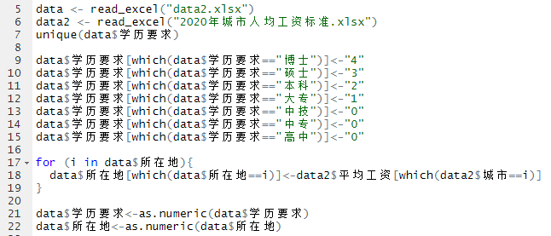
CHAPTER 2-Special Data Processing
Processing of Location variable
Replacing Location variable with the city ’s average salary in 2019.
Data Sources：薪酬网 https://www.xinchou.com/AverageWage/350200/2019

Slide 9
CHAPTER 2-Special Data Processing
Variables of Field, Company Details, Job Introduction, Job details
Using Bag-of-words Model to vectorize the data.
Bag-of-words Model
It is a simplifying representation used in natural language processing and information retrieval (IR).
In this model, a text (such as a sentence or a document) is represented as the bag (multiset) of its words, disregarding grammar and even word order but keeping multiplicity.
Field;
Company Details; Job Introduction; Job Details.
Doing word segmentation，and statistics of high-frequency words.
Choosing the 50 most frequent words, expanding into 50 separate variables, using 0 or 1 to indicate whether the variable is mentioned in the data point.
Getting 200 derived variables.

Slide 10
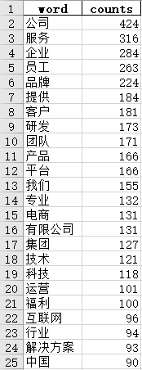
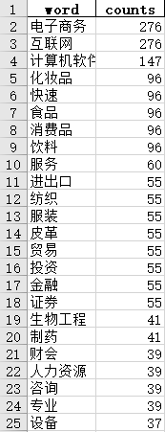
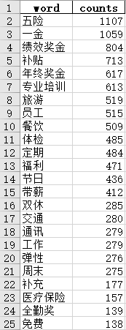
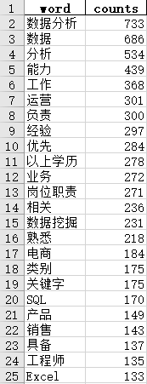
CHAPTER 2-Special Data Processing
This is part of the derived variables we finally screened out for the character variables.
Company Details
Field
Job Introduction
Job Details

Slide 11
PART 03
Model Exploration

Slide 12


CHAPTER 3.1-Variable Selection
Random Forest
Stepwise Regression-Forward Selection
Stepwise Regression-Backward Elimination

Slide 13
CHAPTER 3.1-Variable Selection
Random Forest
A brief introduction of Random Forest：
Feature Important ？
Introduce Noise
Model Performance
• If a feature of the model is significant, when introducing a certain amount of noise into the data distribution of this feature and then doing Random Forest training with the changed data, the performance of the model will get significantly worse.
• Conversely, if the feature is not significant, the performance of the model after retraining will not change too much.

Slide 14
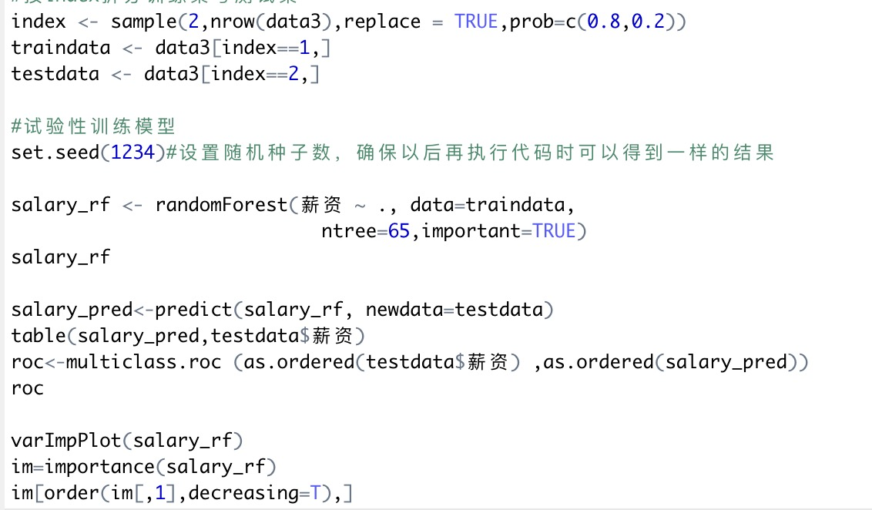
CHAPTER 3.1-Variable Selection
Random Forest
After finishing Random Forest selection, we get 15 significant variables:
Experience Requirements
Academic Requirements
Average Salary
Company Scale
Job Introduction_45(team)
Job Introduction_15(traffic)
Job details _33(user)
Job details _25(communicate)
Job details _41(customer)
Job details _24(team)
Company Details_46 (Company Values)
Company filed_35(Building Materials Industry)
Company filed _22(Professional)
Company filed _34(Engineering)
Company filed _19(Accounting)

Slide 15
CHAPTER 3.1-Variable Selection
Stepwise Regression
Stepwise regression is a method of fitting regression models in which the choice of predictive variables is carried out by an automatic procedure.
In each step, a variable is considered for addition to (Forward Selection) or subtraction from (Backward Elimination) the set of explanatory variables.

Slide 16
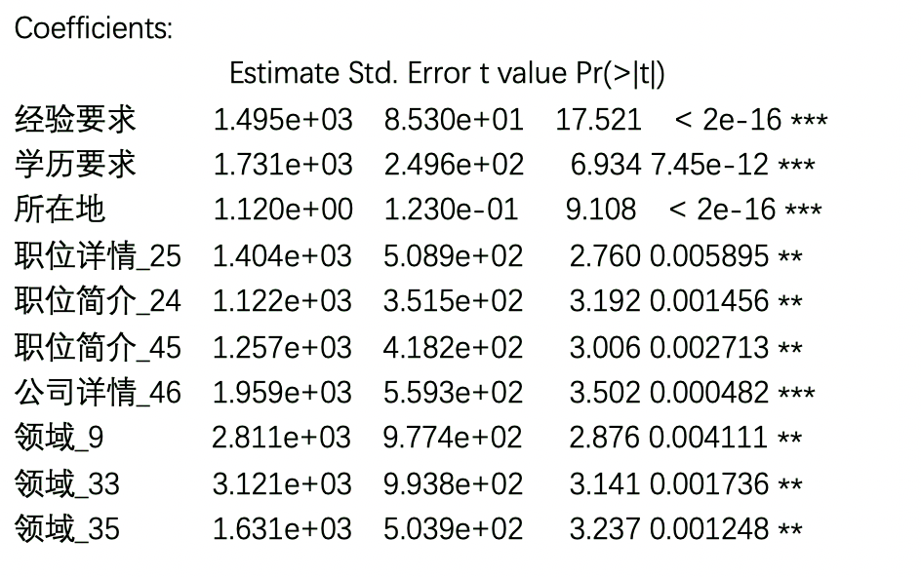
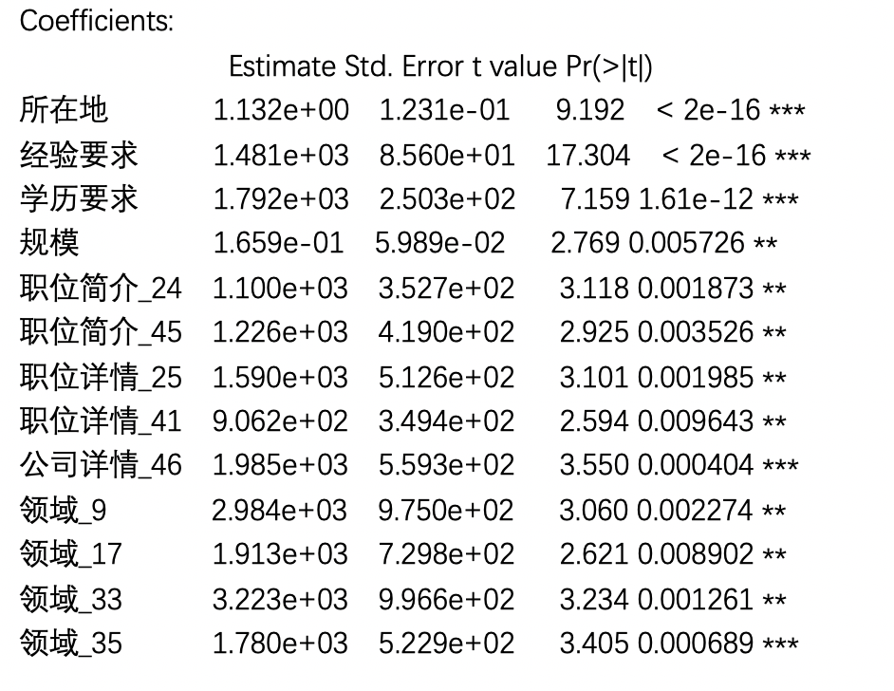
CHAPTER 3.1-Variable Selection
After finishing Stepwise Regression, we have the two different variable selection results:
• 10 variables have been identified as significant features using forward selection.
• 15 variables have been identified as significant features using backward elimination.
Stepwise Regression-Forward
Stepwise Regression-Backward

Slide 17

CHAPTER 3.1-Variable Selection
Random Forest（15）
Stepwise Regression-Forward（10）
Stepwise Regression-Backward（15）
Experience Requirements
Academic Requirements
Average Salary
Company Scale
Job Introduction_45(team)
Job Introduction_15(traffic)
Job details _33(user)
Job details _25(communicate)
Job details _41(customer)
Job details _24(team)
Company Details_46 (Company Values)
Company filed_35(Building Materials Industry)
Company filed _22(Professional)
Company filed _34(Engineering)
Company filed _19(Accounting)
Experience Requirements
Academic Requirements
Average Salary
Company Scale
Job Introduction_24 (shuttle bus)
Job Introduction_45 (team)
Job details _25 (communicate)
Job details _41 (customer)
Company Details _46 (Company Values)
Company filed _9 (Import Export Industry)
Company filed _17 (Bioengineering)
Company filed _33 (Online Games)
Company filed _35 (Building Materials Industry)
Experience Requirements
Academic Requirements
Average Salary
Job Introduction_24 (shuttle bus)
Job Introduction_45 (team)
Job details _25 (communicate)
Company details_46 (Company Values)
Company filed _9 (Import Export industry)
Company filed _33 (online games)
Company filed _35 (building materials industry)

Slide 18
CHAPTER 3.1-Variable Selection
Stepwise Regression-Backward（15）
Stepwise Regression-Forward（10）
If the job introduction includes the content about shuttle bus, the salary of this job would be higher.
The reason for it may be the company which has specialized shuttle bus is probably to be richer, so the company may provide higher salary than other companies.
Experience Requirements
Academic Requirements
Average Salary
Company Scale
Job Introduction_24 (shuttle bus)
Job Introduction_45 (team)
Job details _25 (communicate)
Job details _41 (customer)
Company Details _46 (Company Values)
Company filed _9 (Import Export Industry)
Company filed _17 (Bioengineering)
Company filed _33 (Online Games)
Company filed _35 (Building Materials Industry)
Experience Requirements
Academic Requirements
Average Salary
Job Introduction_24 (shuttle bus)
Job Introduction_45 (team)
Job details _25 (communicate)
Company details_46 (Company Values)
Company filed _9 (Import Export industry)
Company filed _33 (online games)
Company filed _35 (building materials industry)

Slide 19
CHAPTER 3.2-Models
Linear Regression
Lasso Regression
Ridge Regression
Bayesian Ridge
Elastic Net
MLP Regression
Gradient Boosting Regression-GBR

Slide 20
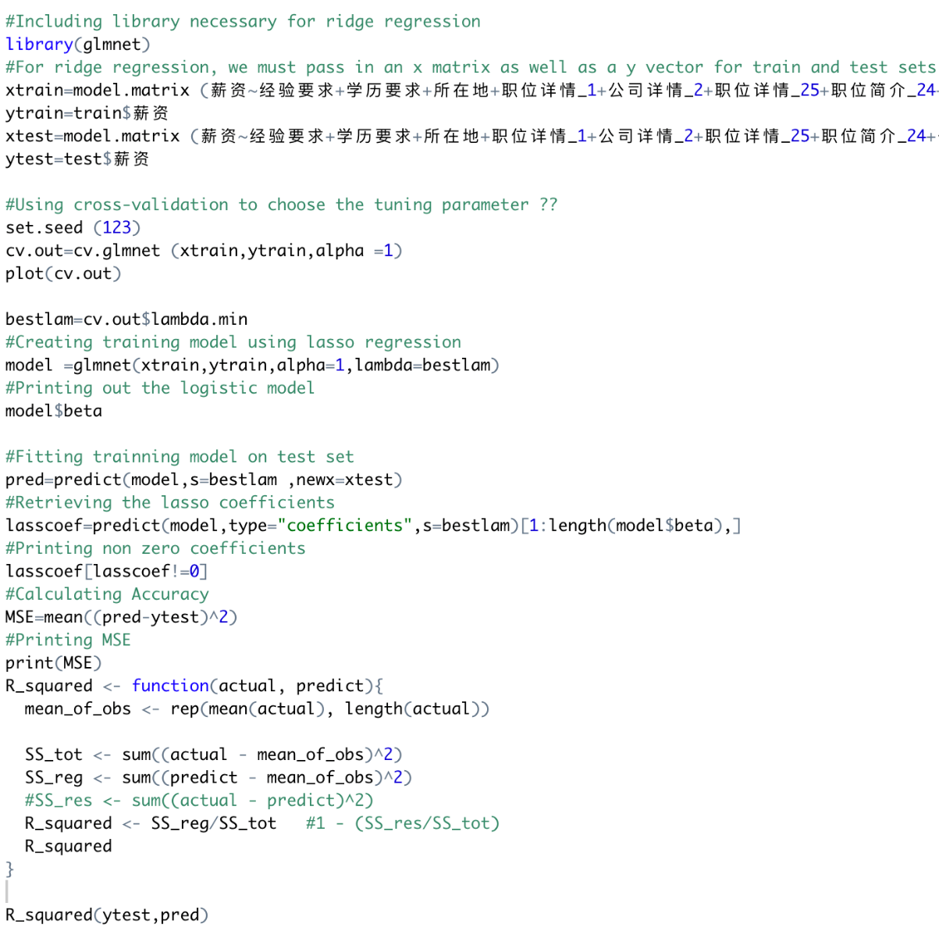
CHAPTER 3.2-Models
Lasso Regression & Ridge Regression
In Lasso regression, regularization is added on the basis of general linear regression, which can ensure the optimal fitting error and make the parameters as "simple" as possible. Because of that, the model have strong generalization ability. Ridge regression is also the simple techniques to reduce model complexity and prevent over-fitting. Ridge and lasso have many similarities; the main difference is their penalty function.
Lasso uses L1 regularization and Ridge has L2 regularization and L2 penalty equal.

Slide 21
CHAPTER 3.2-Models
MLP Regression
What is MLP?
MLP (Multilayer Perceptron) is also known as ANN (Artificial Neural Network). With an input and output layer and a hidden layer, the simplest MLP contains only one hidden layer.
The layers of the perceptron are fully connected to each other (which means that any neuron in the upper layer is connected to any neuron in the lower layer). The bottom layer of the perceptron is the input layer, the middle layer is the hidden layer, and the last layer is the output layer.
What is the advantage ?
Multilayer Perceptron can approximate very nonlinear functions.

Slide 22
CHAPTER 3.2-Models
Gradient Boosting Regression
What is GBR ?
Gradient Boosting is a technique for learning from its mistakes. It's a kind of decision tree. It is essentially a collection of learning algorithms.
Gradient Boosting regression tree can obtain a predicted value at each node. Taking the predicted age as an example, the predicted value represented at the node is not a specific value, but the average value of all ages assigned to this node.
The branch will be exhaustive in every feature of every threshold to find the best point of division, but the standards of the best segmentation is no longer maximum entropy, but the minimum mean square error.
The most reliable branch is found by continuously minimizing the mean square error (mse). The regression tree will continue to branch until the age of all the people in the leaf nodes is unique. If the age of the last leaf node is not unique, the average age of all the nodes is selected as the predicted age.
What is the advantage ?
Flexible processing of various types of data, including continuous values and discrete values.
In the case of relatively little parameter adjustment time, the predicted preparation rate can also be relatively high. This is relative to SVM.

Slide 23
CHAPTER 3.3-Modeling process
Ten folds cross validation
Seven kinds of model
Three sets of eigenvalues
Four evaluation indicators
In model training, we put the three groups of different variables we got before into each of the 7 models we selected, and for each training model, we conducted ten fold cross validatio. We selected four indexes to evaluation model, which are explained variance, mean absolute error, mean squared error and r squared.

Slide 24
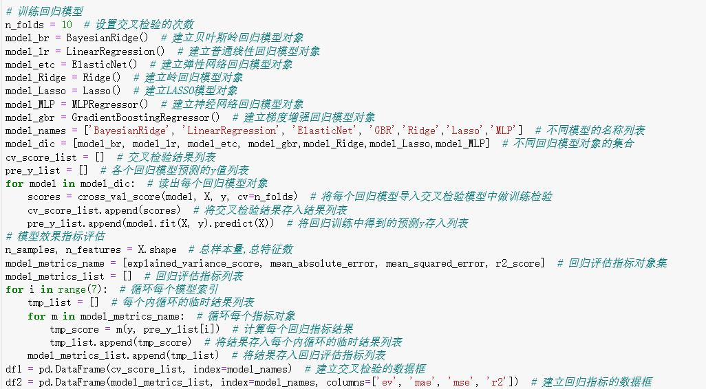
In the process of training the model, we choose to use python to do this. Because r language is not very good for some of our models, especially multi-layer perceptron regression and Gradient Boosting regression. Using python for this is the best option. Here is our python code. We performed seven models and three sets of variables and output the results at the same time. This is easy for model evaluation and selection.
CHAPTER 3.3-Modeling process

Slide 25

PART 04
Evaluation & Conclusion

Slide 26
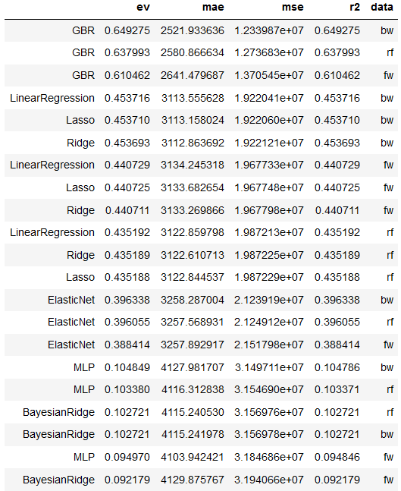
CHAPTER 4.1-Modeling Conclusion
For 3 sets of variables and 7 models, we got 21 results.
We found that for each set of variables, the performance of GBR was the best.
At the same time, we also confirm that the variable of Backward group is the best.
Therefore, we finally decide to choose the variables of GBR model with the variable of Backward group as the final model.

Slide 27
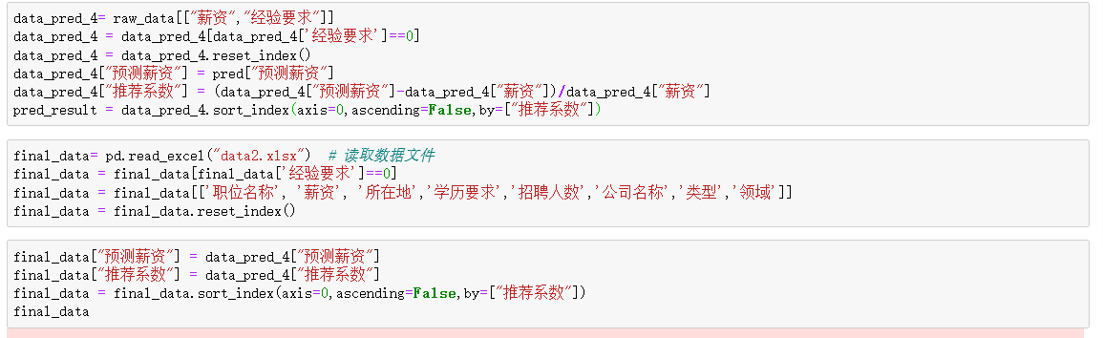
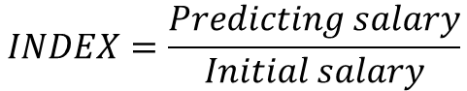
CHAPTER 4.2-Model application
$$INDEX=\frac{Predicting salary}{Initial salary}$$
Pulled out all the job information of campus recruitment;
Changed the experience in the recruitment information to 3 years;
Introduced the variables into the GBR model;
Obtained the predicted value of the salary of the positions after three years of work;
Calculated the projected increase in the original salary as an indicator of the potential for salary growth over the next three years.

Slide 28
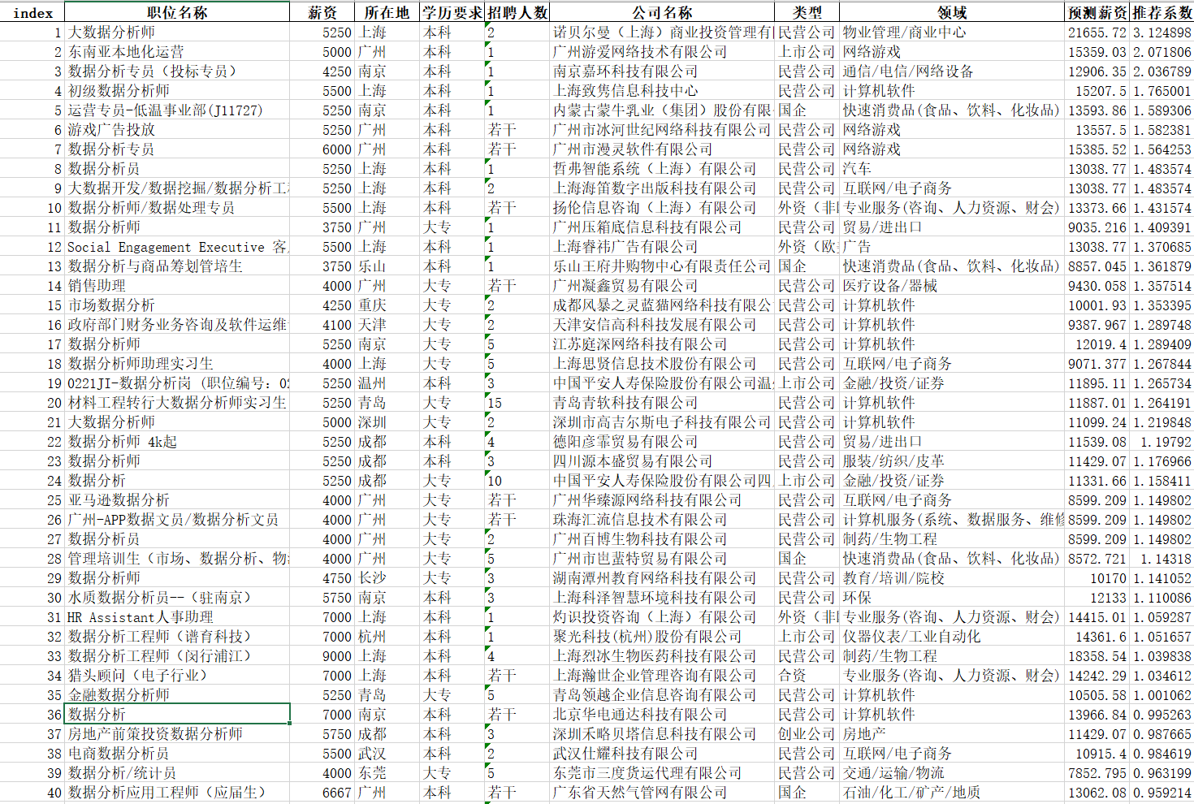
CHAPTER 4.2-Model application
Add the forecast salary and recommendation index back to the raw data;
Sort the raw data by the recommendation index;
Get the recommendation ranking of campus recruitment posts based on the possible future growth of post salary.

Slide 29
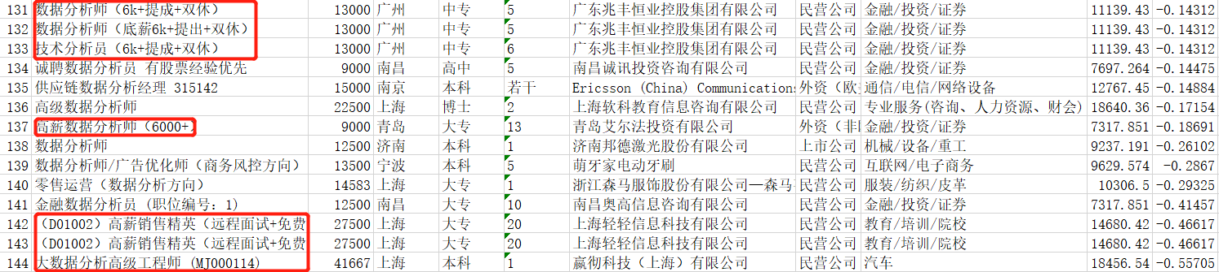
CHAPTER 4.2-Model application
An unexpected finding was that our ranking was able to identify false job postings.
Some companies deliberately inflate their salaries in order to make their job information more attractive.
For example, as we can see in the picture, in fact, there are some positions whose salary is only 6,000 yuan a month, but he wrote 13,000 yuan in the recruitment information. The result predicted by our model and the false salary in the recruitment information resulted in a negative growth, which is obviously abnormal.
By sorting, the abnormal positions of the recruitment information are put at the end, which can also realize the punishment of the recruitment website for false recruitment information.

Slide 30
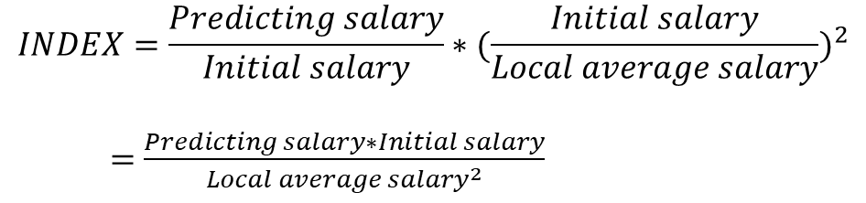
CHAPTER 4.2-Model application
$$INDEX=\frac{Predicting salary}{Initial salary}∗({\frac{Initial salary}{Local average salary})}^{2}$$
$=$ $\frac{Predicting salary∗Initial salary}{{Local average salary}^{2}}$
In order of expected salary growth, some jobs with low initial salary were ranked very high.
To solve this problem, we designed a new index. On the basis of the original index, we have multiplied the ratio of the initial salary to the local average wage. At the same time, in order to amplify the impact of the initial salary, we squared this parameter.

Slide 31
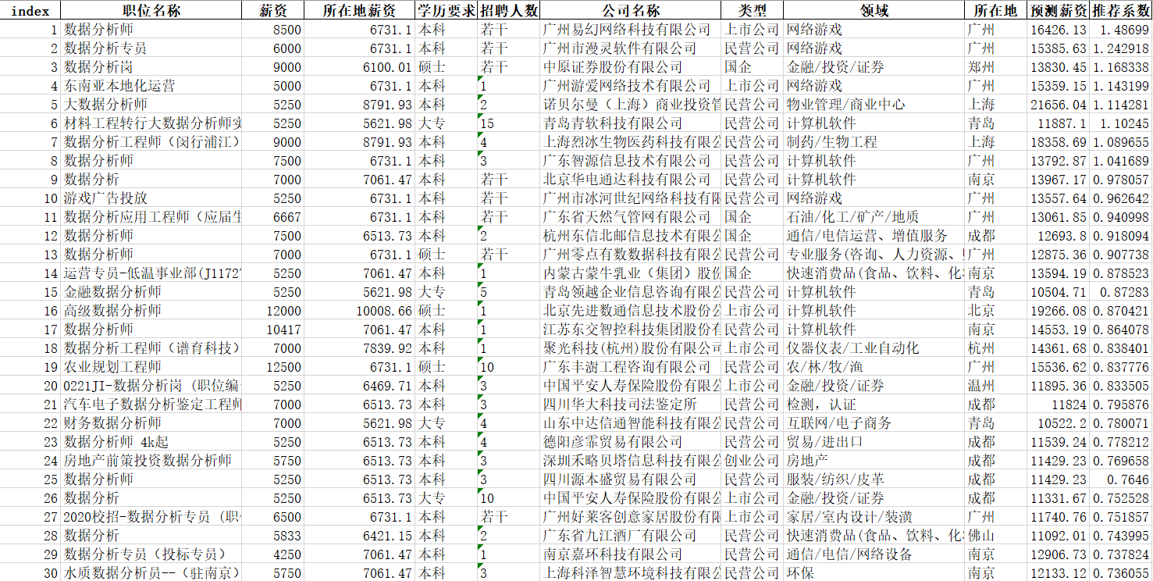
CHAPTER 4.2-Model application
As can be seen from the latest ranking results, the positions of those jobs with very low initial salary have been pulled down, and the ranking of those jobs with relatively high initial salary has significantly increased.
As a result, the new ranking is more consistent with the general perception that jobs in games and software, for example, are much more likely to be paid more than jobs in other industries.

Slide 32
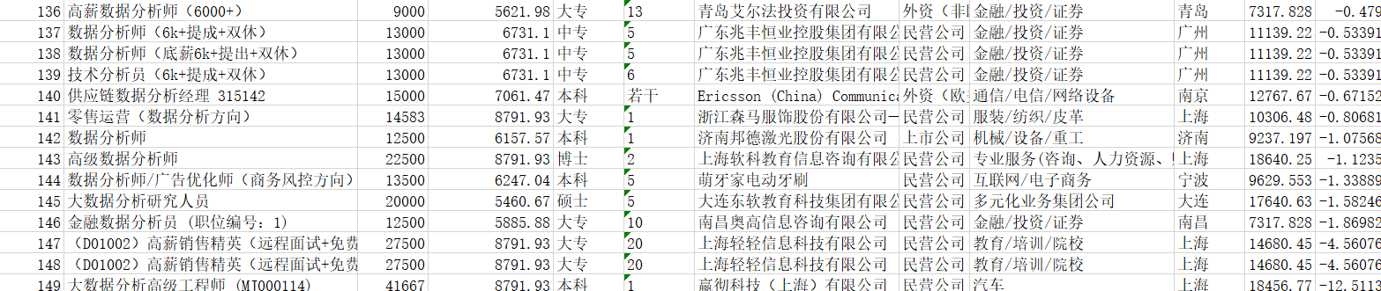
CHAPTER 4.2-Model application
At the same time, the new index still plays a role in the identification of false recruitment information, which is still at the bottom of the recommended ranking.

Slide 33
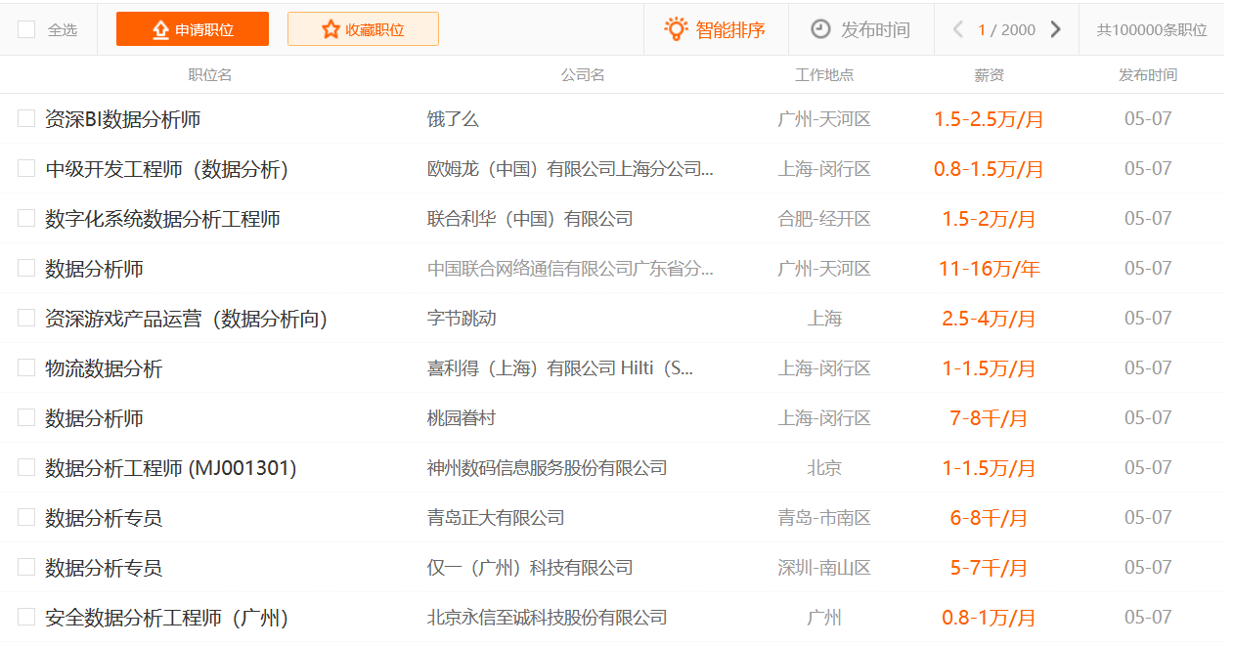
CHAPTER 4.2-Model application
Most job sites already have intelligent ranking, but it's just a combination of when information is posted and how relevant it is.
And our work can be directly applied in the recruitment website search ranking, as a job recommendation ranking function.

Slide 34

PART 05
Further Improvements

Slide 35

CHAPTER 5-Further Improvements
Challenges:
1. Crawling data is more troublesome;
2. Data vectorization and natural language processing is difficult;
3. Need to find and learn more models to make different attempts.
Further Improvements:
1.Need more training samples;
2.The processing of feature variables of natural language also needs to be re-screened through more training data.

Slide 36
PART 06
References

Slide 37
CHAPTER 6-References
Scikit-learn : Gbr (gradient Boosting Regression)
https://blog.csdn.net/SA14023053/article/details/51817650
Intelligent Recommendation
https://blog.csdn.net/u010380670/article/details/85221209?ops_request_misc=%257B%2522request%255Fid%2522%253A%2522158879992719724835841711%2522%252C%2522scm%2522%253A%252220140713.130102334..%2522%257D&request_id=158879992719724835841711&biz_id=0&utm_medium=distribute.pc_search_result.none-task-blog-2~all~baidu_landing_v2~default-4
Machine learning summary : linear regression, ridge regression, lasso regression
https://blog.csdn.net/hzw19920329/article/details/77200475?ops_request_misc=%257B%2522request%255Fid%2522%253A%2522158874687519724848356120%2522%252C%2522scm%2522%253A%252220140713.130102334.pc%255Fblog.%2522%257D&request_id=158874687519724848356120&biz_id=0&utm_medium=distribute.pc_search_result.none-task-blog-2~blog~first_rank_v2~rank_v25-1
Lasso regression
https://blog.csdn.net/qq_38650208/article/details/88766738?ops_request_misc=%257B%2522request%255Fid%2522%253A%2522158874687519724848356120%2522%252C%2522scm%2522%253A%252220140713.130102334.pc%255Fblog.%2522%257D&request_id=158874687519724848356120&biz_id=0&utm_medium=distribute.pc_search_result.none-task-blog-2~blog~first_rank_v2~rank_v25-4

Slide 38


THANKS

